Slide 1
DEEP NEURAL NETWORKS -ASSIGNMENT 2
PAVITRA ANKESH
CSE- 5D
ENG19CS0221
Google colab link:
https://colab.research.google.com/drive/11e9YoSDtnpqHzhwBGRsXRQ7jeRTHgR8F?usp=sharing

Slide 2
CONTENTS
Introduction to Deep Neural Networks
Basic concepts of Deep Neural Networks
Activation Functions
Model Fitting
Implementation of DNN for Classification
Implementation of DNN for Linear Regression
References

Slide 3
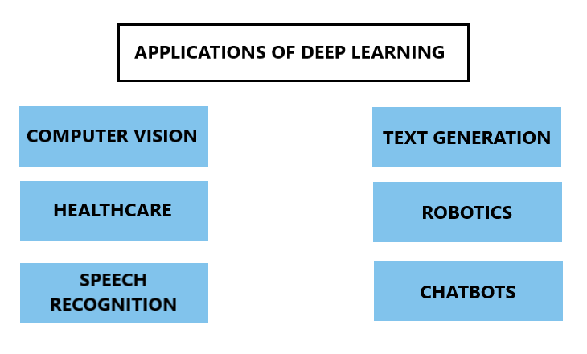
INTRODUCTION TO DEEP NEURAL NETWORKS
Artificial Neural Network:
An artificial neural network is an interconnection or network of artificial neurons. An artificial neuron is a simulation of a neuron in a machine.
Deep Learning:
Deep learning is a class of Artificial Intelligence which involves processing input data using artificial neural networks in order to obtain a target output.

Slide 4
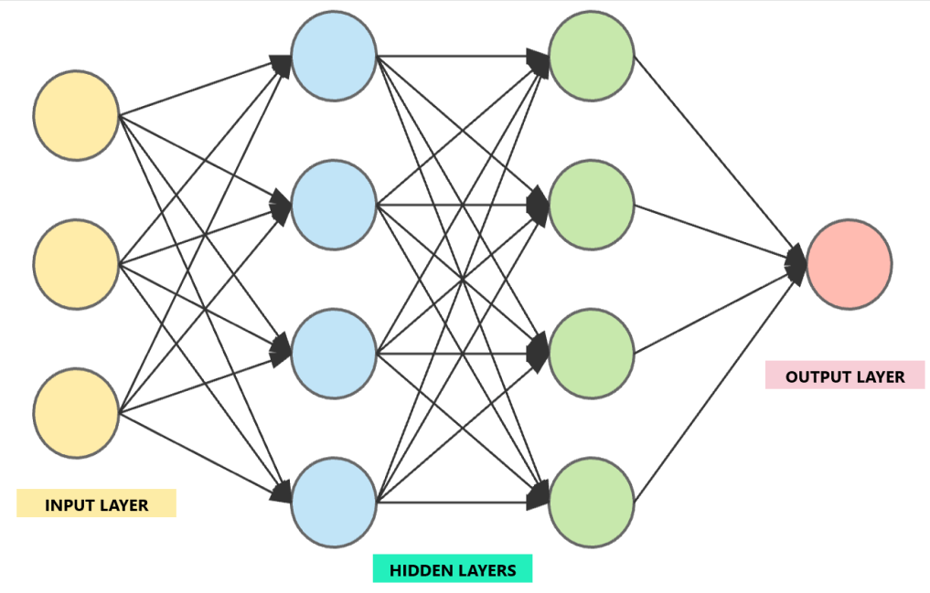
INTRODUCTION TO DEEP NEURAL NETWORKS
Deep Neural Networks:
A deep neural network (DNN) is an artificial neural network with an input layer, multiple hidden layers and an output layer.
Input Layer:
The input layer takes large volumes of data as input.
Hidden Layers:
The hidden layer processes the input data and carries out feature extraction. Each layer has weights and biases of inputs which can be updated.
Output Layer:
The output layer generates the required output.

Slide 5
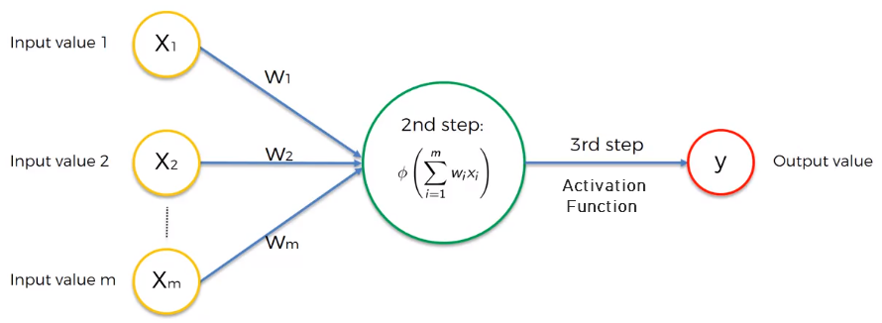
INTRODUCTION TO DEEP NEURAL NETWORKS
Deep Neural Networks:
In a deep neural network, each input signal is assigned a weight. This weight is multiplied by the input value and the neuron stores the weighted sum of all the input variables. An activation function is then applied to the weighted sum, which results in the output signal of the neuron.

Slide 6
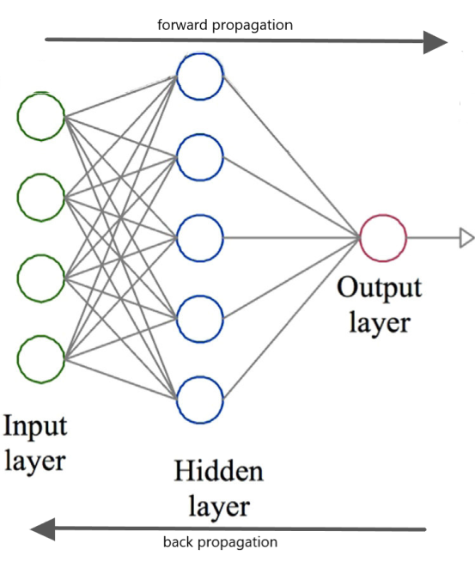
BASIC CONCEPTS OF DEEP NEURAL NETWORKS
Forward propagation:
Forward propagation involves moving in only one direction, from input layer to the output layer in a neural network. During forward propagation, the input weights are assigned randomly hence, the output obtained isn’t accurate.
Back propagation:
Back propagation involves moving from the output layer to the input layer in a neural network. Back propagation is used to adjust the input weights in order to get more accurate outputs or reduce the error.
Epoch:
One epoch is when the dataset is passed forward and backward through the neural network once.

Slide 7

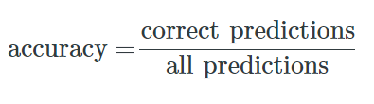
BASIC CONCEPTS OF DEEP NEURAL NETWORKS
Loss:
The loss is the difference between the predicted and actual values. A loss function is used to improve the output accuracy. Gradient Descent is a technique used to reduce the loss.
Metrics:
A metric is a function that is used to judge the performance of the neural network.
Accuracy:
Accuracy is defined as the percentage of correct predictions made by the neural network. It can be calculated easily by dividing the number of correct predictions by the number of total predictions.

Slide 8
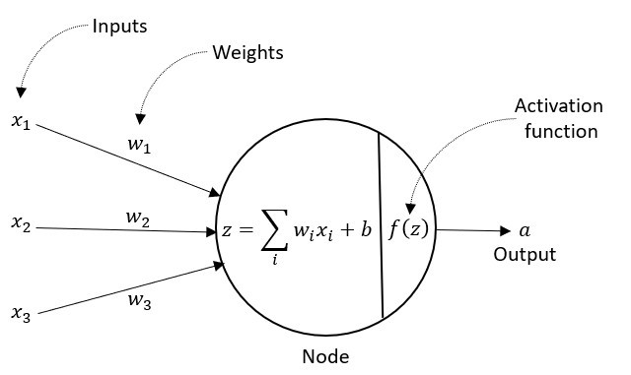
ACTIVATION FUNCTIONS
The activation function translates the input signals to output signals. They decide whether the neuron should be activated or not i.e. they decide if output of a neuron goes to the next layer.
After obtaining the weighted sum of all the input variables with the bias we get a linear equation: z=wx+b.
A non-linear function is then applied on it:
f(z)= f(wx+b).
Neural networks use non-linear activation functions because it can help the network learn complex data and provide accurate predictions.

Slide 9
Commonly applied Activation Functions
ACTIVATION FUNCTIONS
Sigmoid:
The sigmoid function is used when the model is predicting probability. The sigmoid transformation generates a more smooth range of values between 0 and 1, i.e. it normalizes the output of each neuron.
Hyperbolic tangent(tan-h):
The hyperbolic tangent function is similar to the sigmoid function but has a range of -1 to 1.
Rectified Linear Unit (ReLU):
The ReLU function gives the value 0 when the output is lesser than 0 and gives the output value itself when the output is greater than or equal to 0. This function is most commonly used due to it’s efficiency.

Slide 10
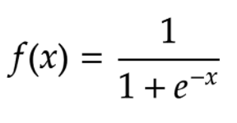
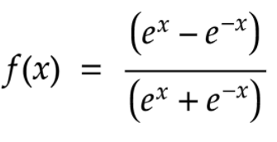

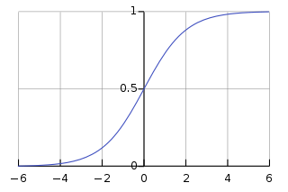
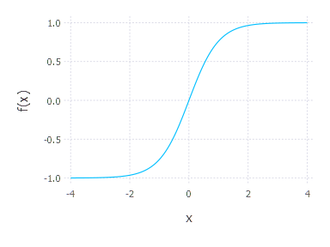
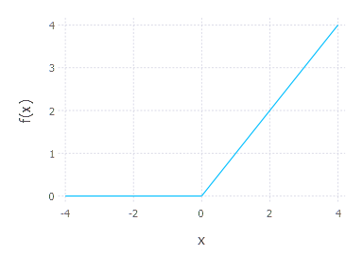
Commonly applied Activation Functions
ACTIVATION FUNCTIONS
SIGMOID
Equation:
Graph:
HYPERBOLIC TANGENT
Equation:
Graph:
RECTIFIED LINEAR UNIT
Equation:
Graph:

Slide 11
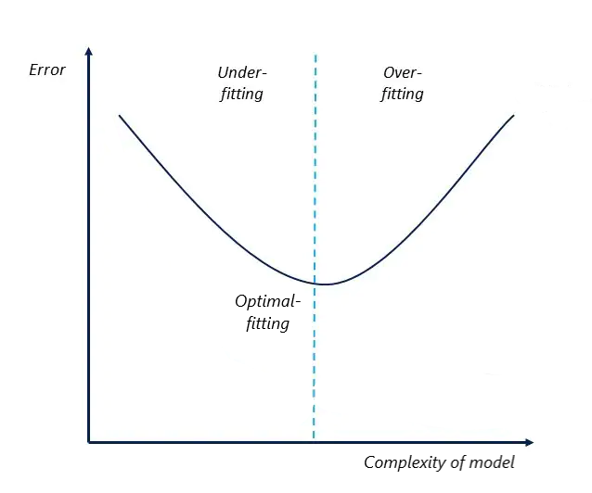
MODEL FITTING
Model fitting is a measure of how well a model generalizes on new data based on the data on which it was trained.
A model that is optimally fit produces more accurate outcomes.
A model that is overfit matches the data too closely resulting in greater error.
A model that is underfit doesn’t match closely enough resulting in greater error.

Slide 12
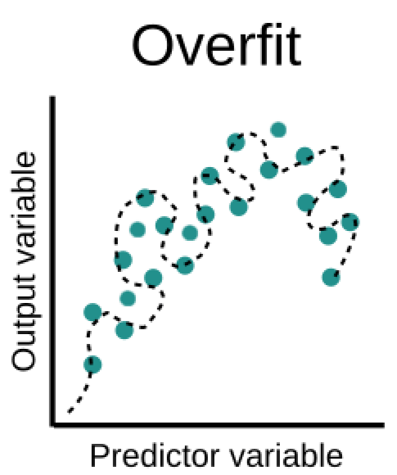
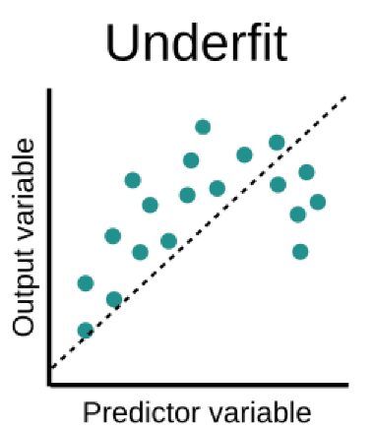
MODEL FITTING
Overfitting:
Overfitting refers to a model that fits the training data too well. It provides good performance on the training data and poor generalization to other data. Due to overfitting, a model cannot perform accurately against unseen data. Hence, overfitting negatively impact the models ability to generalize.
Underfitting:
Underfitting refers to a model that can neither model the training data nor generalize to new data. Underfitting provides a poor relationship between the input and output variables. Hence, it negatively impacts the models ability to train and generalize.

Slide 13
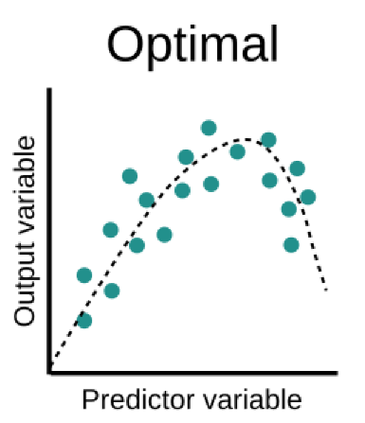
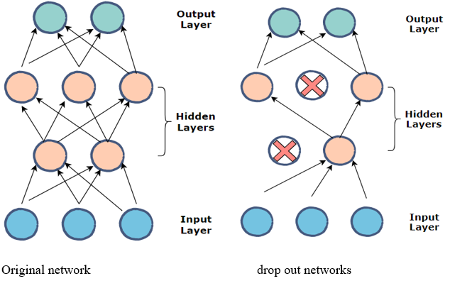
MODEL FITTING
Optimal fitting:
Optimal fit refer to a model that suitably learns the training dataset and generalizes well to the old out dataset. The objective of a neural network is to have a model that performs well both on the data that we used to train it and the new data on which the model will be used to make predictions.
Dropout:
Dropout is a regularization method that involves dropping out random nodes during training. Regularization using dropout helps to reduce overfitting and improve generalization error in deep neural networks of all kinds.

Slide 14
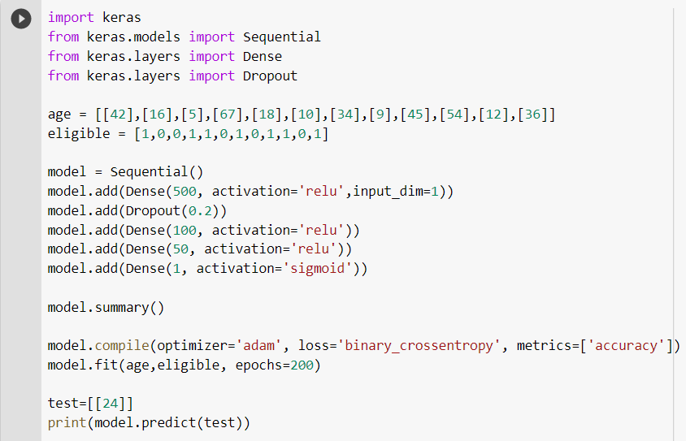
IMPLEMENTATION OF DNN FOR CLASSIFICATION
Program Code:

Slide 15
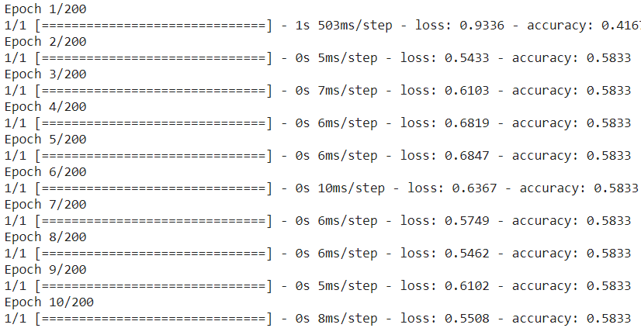
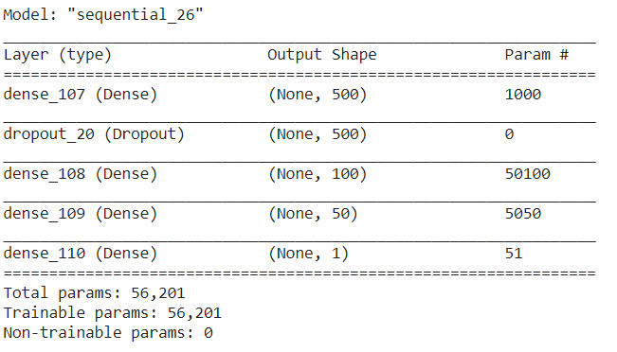
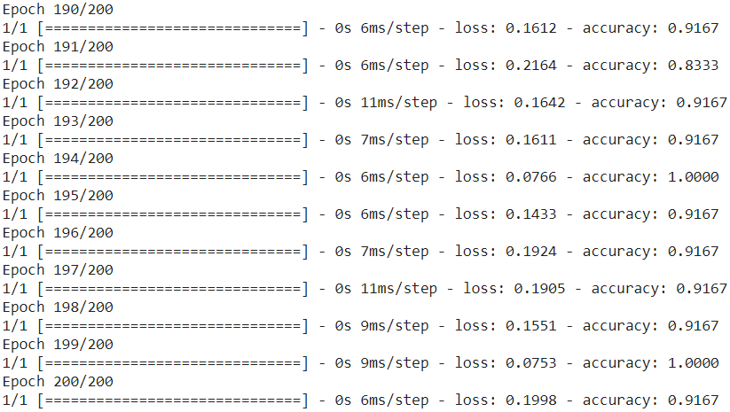
IMPLEMENTATION OF DNN FOR CLASSIFICATION
Model summary:
Predicted output:

Slide 16
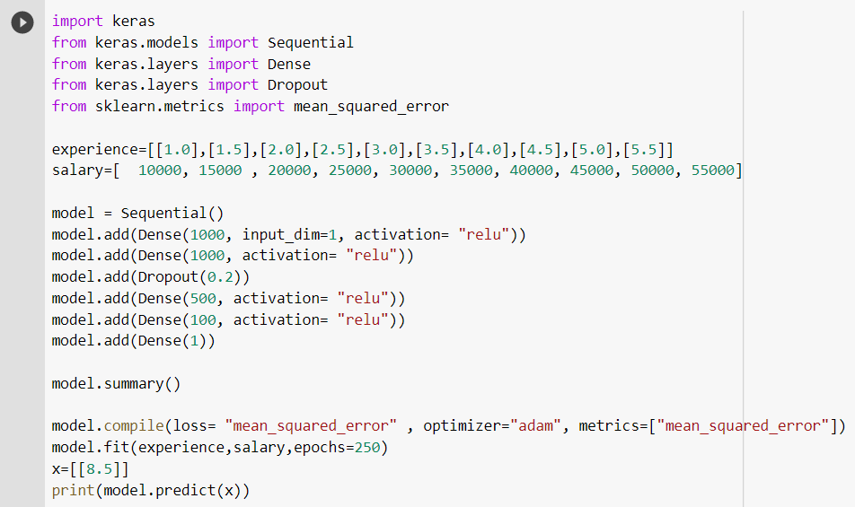
IMPLEMENTATION OF DNN FOR LINEAR REGRESSION
Program Code:

Slide 17
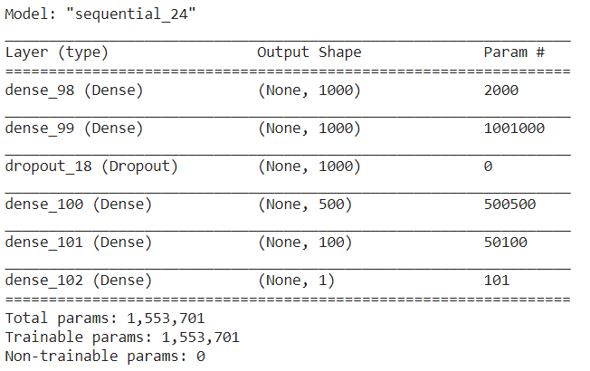
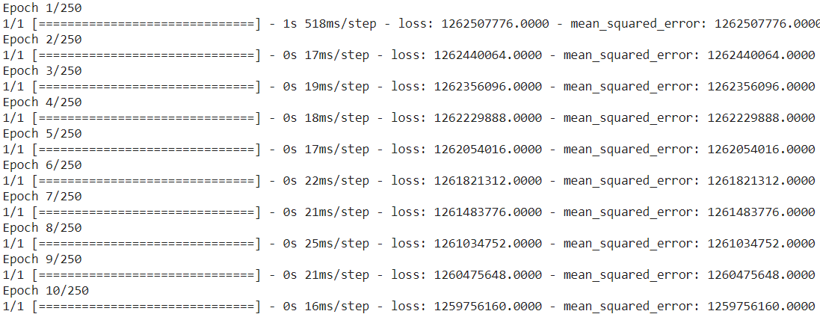
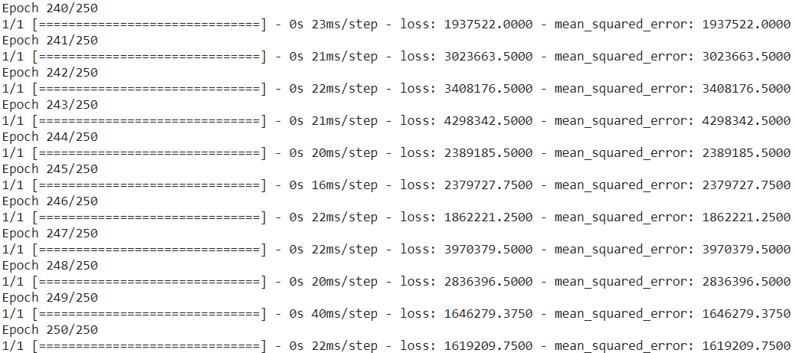
IMPLEMENTATION OF DNN FOR LINEAR REGRESSION
Model summary:
Predicted output:

Slide 18
REFERENCES
https://www.simplilearn.com/tutorials/deep-learning-tutorial/neural-network?source=sl_frs_nav_playlist_video_clicked
https://www.guru99.com/deep-learning-tutorial.html
https://blog.quantinsti.com/forward-propagation-neural-networks/
https://www.analyticsvidhya.com/blog/2017/05/25-must-know-terms-concepts-for-beginners-in-deep-learning/
https://medium.com/@snaily16/what-why-and-which-activation-functions-b2bf748c0441
https://www.v7labs.com/blog/neural-networks-activation-functions
https://machinelearningmastery.com/overfitting-and-underfitting-with-machine-learning-algorithms/

